Slide 1
PHPMyadmin – User and linked database
Guide 04

Slide 2
Importance of user and linked database
Should never use root to access database and admin from a website
Should create a user and a database linked for security, root is too powerful.

Slide 3
Starting up
See Guide 03 on staring Laragon, its services and opening PhpMyAdmin
Login as root (username root, no password)

Slide 4
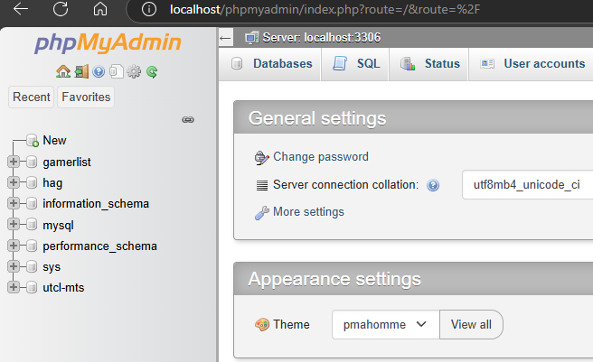
User accounts
Ensure you are "home"
2. ensure you are full screen
2. Click "user accounts"

Slide 5
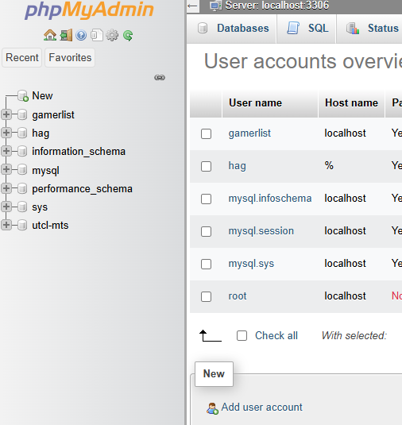
Add new user
Click "add user account"

Slide 6
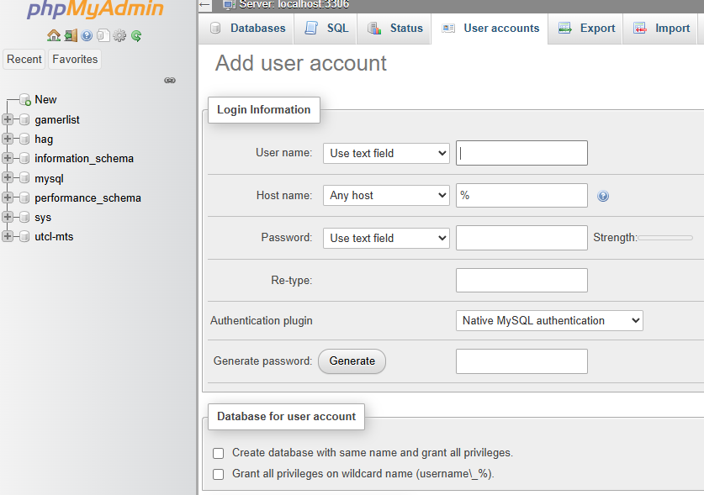
Fill out details
Fill out details for new user IMPORTANT
Click here IMPORTANT
Scroll to the bottom, click "go"

